Slide 1


LickiLicky. Inc
Order Management Scenario
Notes:
READ PLEASE!
Before you open this template be sure that you have installed these fonts:
OpenSans-CondLight.ttf from: http://www.fontsquirrel.com/fonts/open-sans-condensed
Titillium-Light.otf from: http://www.fontsquirrel.com/fonts/Titillium
All fonts are free for use in commercial projects!
If you have any problems with this presentation, please contact with me from this page: http://graphicriver.net/user/Bandidos?ref=bandidos
When add image, you must sent it to back! Right Click on Image -> Send to Back -> Send to Back

Slide 2


Outline
1
Business Scenario
Integrations
Out of The Labs
Diagrams
EI Concepts

Slide 3
Business Scenario
2
Customer places order from LOMS
IM performs content-based routing to plant
Google Maps API web service invocation to get ETA
Content-Based Routing to clients of invoice
State-To-Region web service invocation
Plant checks and update database
IM mails the invoice & SMS ETA
IM informs supplier for possible order restock

Slide 4
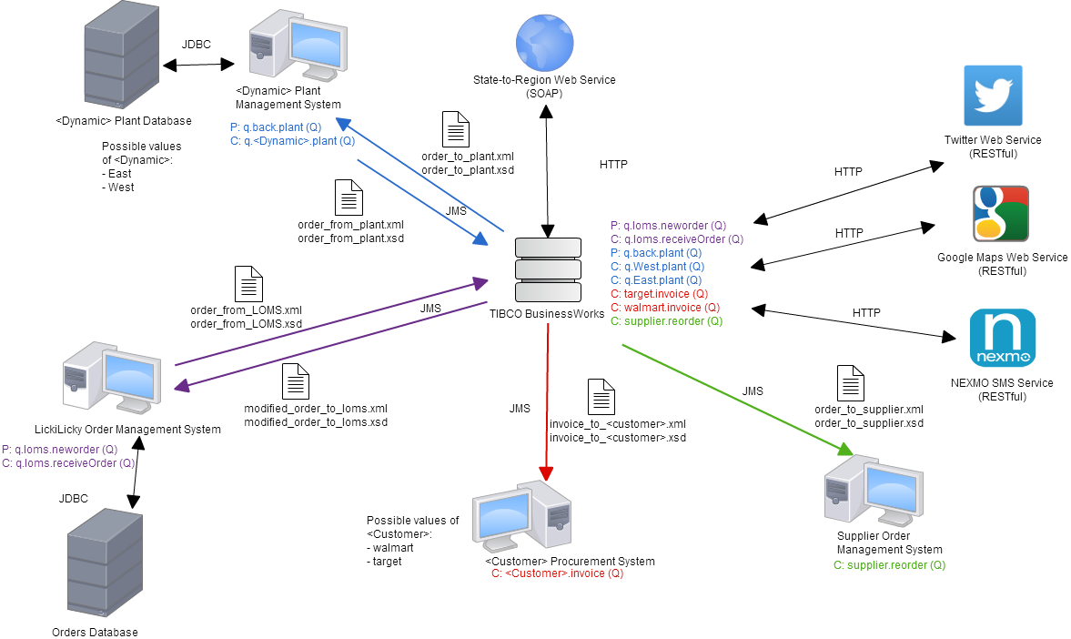
Technical Overview Diagram
3

Slide 5
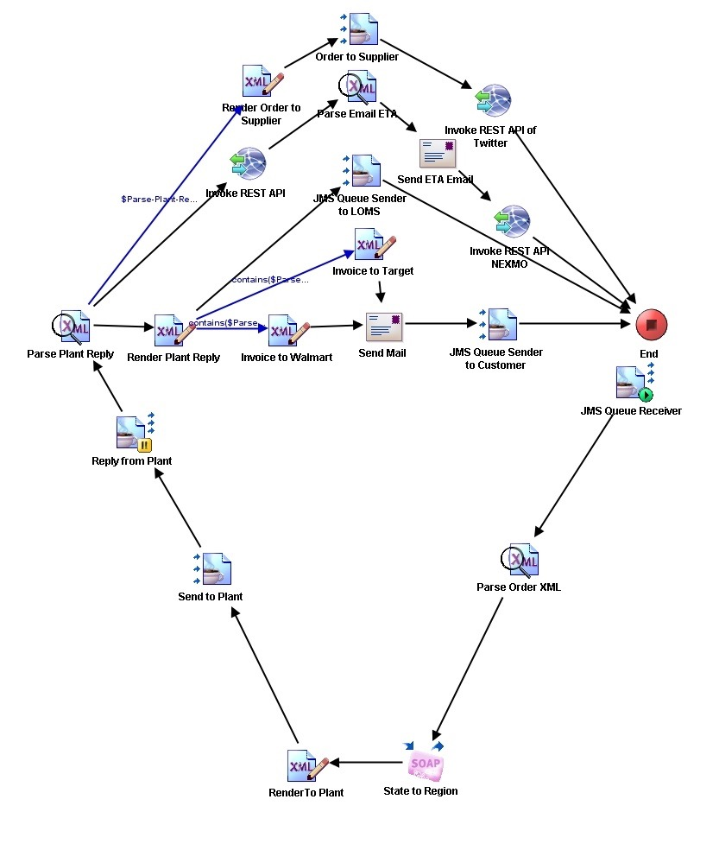
Process Definition Diagram
4

Slide 6


Integration 1
5
TIBCO Business Works
West Plant
LOMS
East Plant

Slide 7
Integration 2
6
TIBCO Business Works
Walmart
LOMS
Target

Slide 8
Integration 3
7
TIBCO Business Works
LOMS
Supplier

Slide 9
Content-Based Routing
8
Routing to the east or west plant based on the region
Routing invoice to target or walmart based on the company name

Slide 10
Data Transformation
9
Data transformation to clients format
Data transformation to plants format
Data transformation to supplier format

Slide 11



Web Services
10
Twitter Live Tweet API
Nexmo SMS Service
State-to-Region using asp.net
C#
Navigation Google Maps API

Slide 12
Beyond The Lab
11
X Path
Email
Web Services
The x path is used to define the multiple conditions including if-else, datetime and content-based routing
By using Tibco Business Work email plugin, emails will be sent to the supplier, walmart / target and plants
Web services such as Twitter Live Tweet API, Navigation Google Maps API, Nexmo SMS Service and State-to_region web services are used to integrate the processes

Slide 13
QUESTION
TIME
Notes:
When add image, you must sent it to back! Right Click on Image -> Send to Back -> Send to Back

